Slide 1
Sulphur
Created By –
Mohd Seraj Alam 01020703114
Varun Taneja 01620703114
Abha Kumari 03620703114
Kishor Das 00320703114
Ravinder Kumar 01920703114
A backend manager

Slide 2
About
What is Sulphur?
Sulphur is a blogging tool & a Web Content Management System (WCMS) based on Django Framework, Python.
It uses MySQL as the DBMS and Django Development Server.
It provides a rich library to its users to write the front-end code for their website and Sulphur will take care of all the backend issues.
Sulphur is very easy to use and a web application that makes it platform independent.
Sulphur Project is inspired from the WordPress which is written in PHP while Sulphur is in Python.

Slide 3
Getting started with WCMS
What is a Web Content Management System?
A web content management system (WCMS) is an application which is used to automate the management of the backend and database related tasks. Its makes an abstraction of user from the backend and manages all the procedures which are associated with the database.
Creates Database Tables and keep track of records.
Manages the content delivery with a number of functions defined in its library.
Insert, delete, update the data in the tables without any interaction of user to Database application.

Slide 4
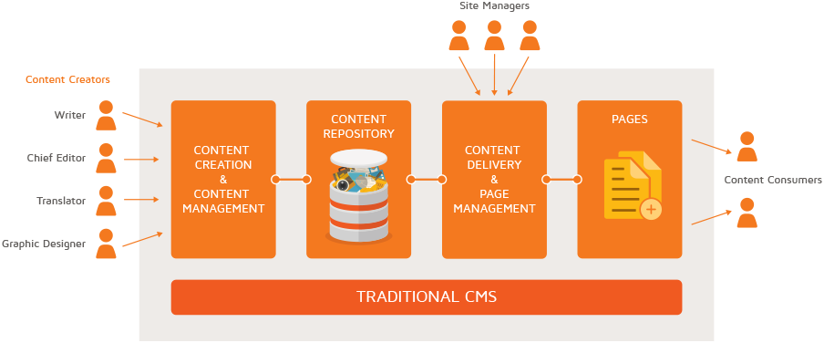
Working
How a CMS Works

Slide 5
What can a CMS do?
Allows web page updates using an ordinary web browser(e.g. Firefox, Safari, Mozilla etc. )
Reduce overall work as those responsible for content can update it directly and submit it for approval
Reduce overall work as those responsible for content can update it directly and submit it for approval.
Reduce overall work as those responsible for content can update it directly and submit it for approval.
Easy to manage simple content pages

Slide 6
Basic features of CMS
Access Control: Who is allowed to do what?
Version Control: Return to a previously saved version.
Library: Page templates, pre-installed jQuery and Bootstrap libraries.
Content Repository: Text and other assets stored in a database repository without user intervention.
Publishing Functionality: Creates web pages and have a feature to publish and unpublish them without deleted.

Slide 7
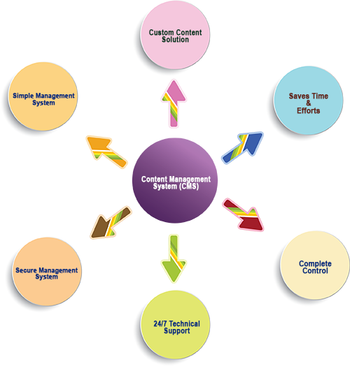
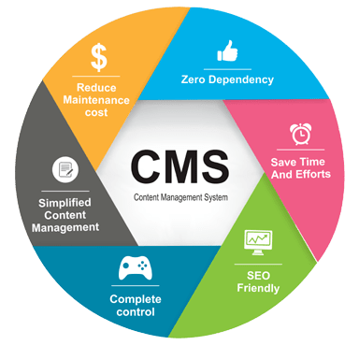
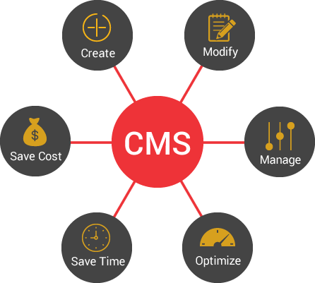
Features of CMS

Slide 8
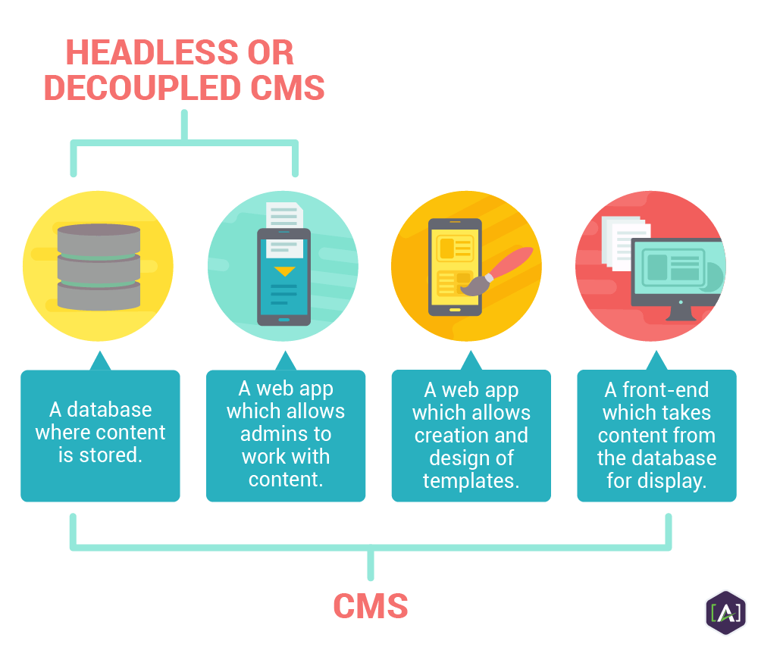
Components of CMS

Slide 9





Workflow in sulphur
Forms
Urls
Views
Database
html

Slide 10
Benefits of Sulphur
Accuracy: Enables the approval process to confirm the accuracy of the information
Availability: Ensure that the information is published, backed up, versioned and restorable through automated process.
Discoverability: Ensure that the information can be located through effective use of metadata driven searches.
Relevance: Enable a process to ensure relevance through the use of approval processes.
Timeliness of information: Simplify and automate the publication of website information and enable removal of information through the use of automated scheduling process.

Slide 11
Sulphur: up & running
Install Sulphur and related packages.
Create Sulphur Database.
Configure the MySQL with Sulphur.
Signup and Login to the Sulphur.
Create a Visual Design for your site or use the prewritten design.
Write some posts and articles and publish them.
Access your website within minutes.

Slide 12
Sulphur reaction
Content is the winner – Visitors are more frequent and they must have a reason to come back.
Social Media Integration – It helps to make your branding and build a trust of users on you.
Dynamic Website: It creates an opportunity for frequent updates. Admin able to generate content within minutes without creating a whole new webpage.

Slide 13
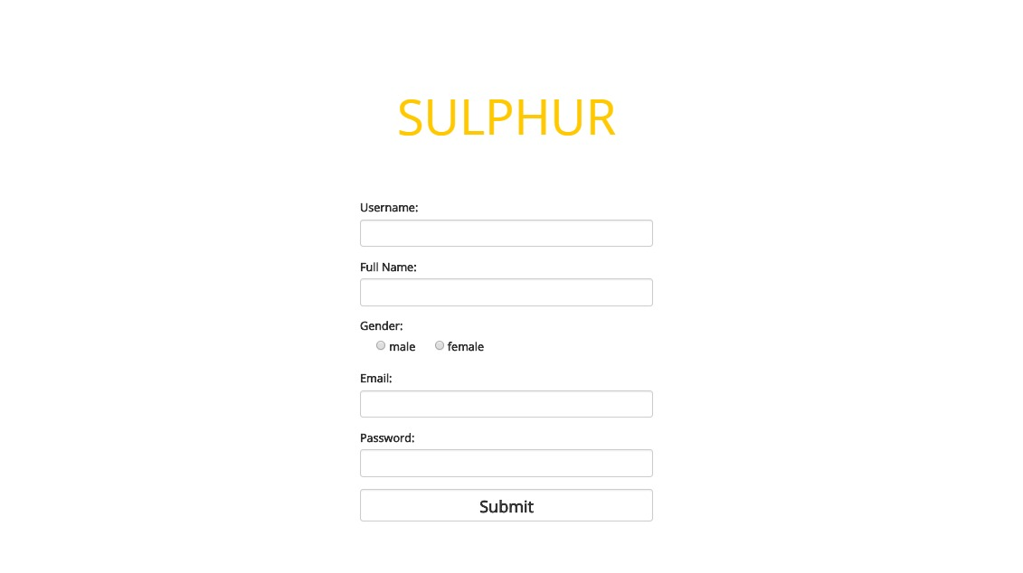
Sulphur interface

Slide 14
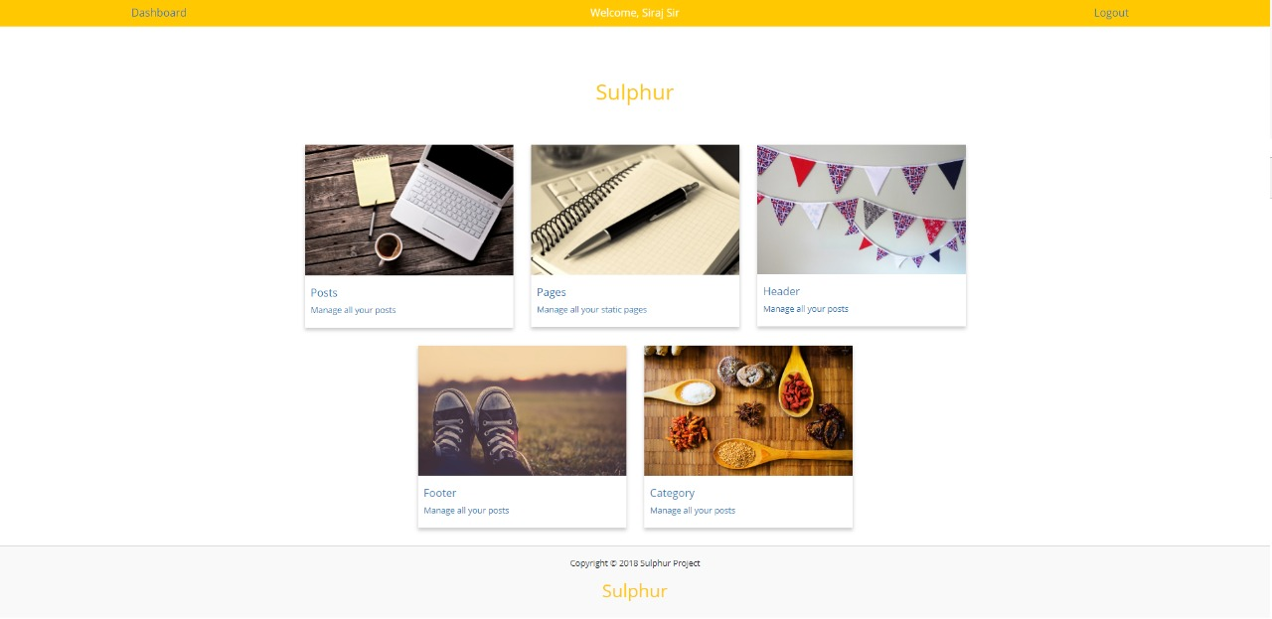
Sulphur interface

Slide 15
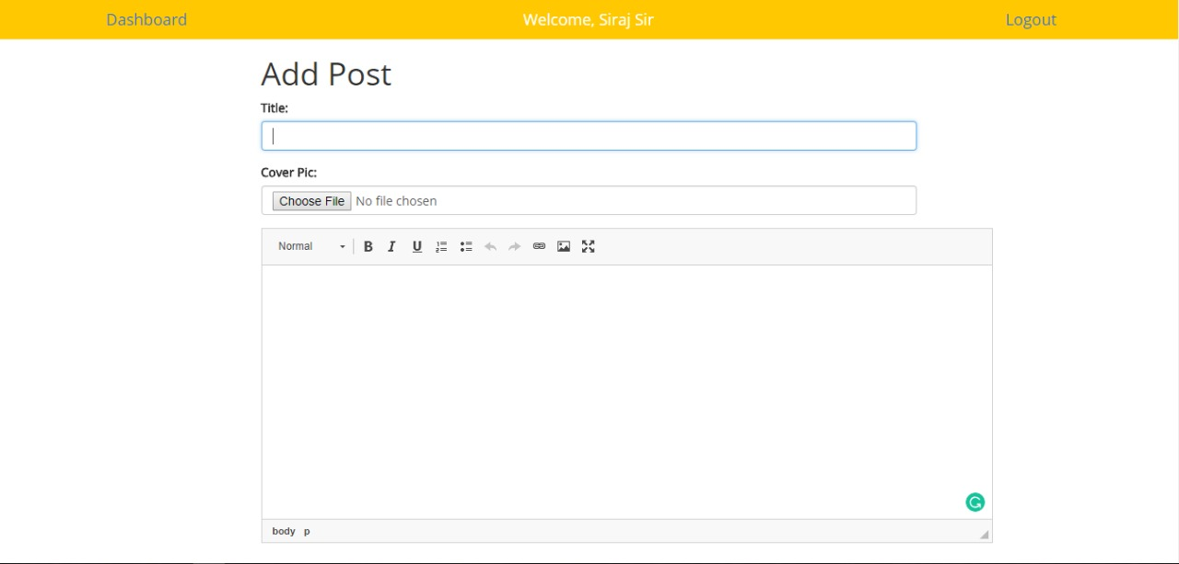
Sulphur interface

Slide 16
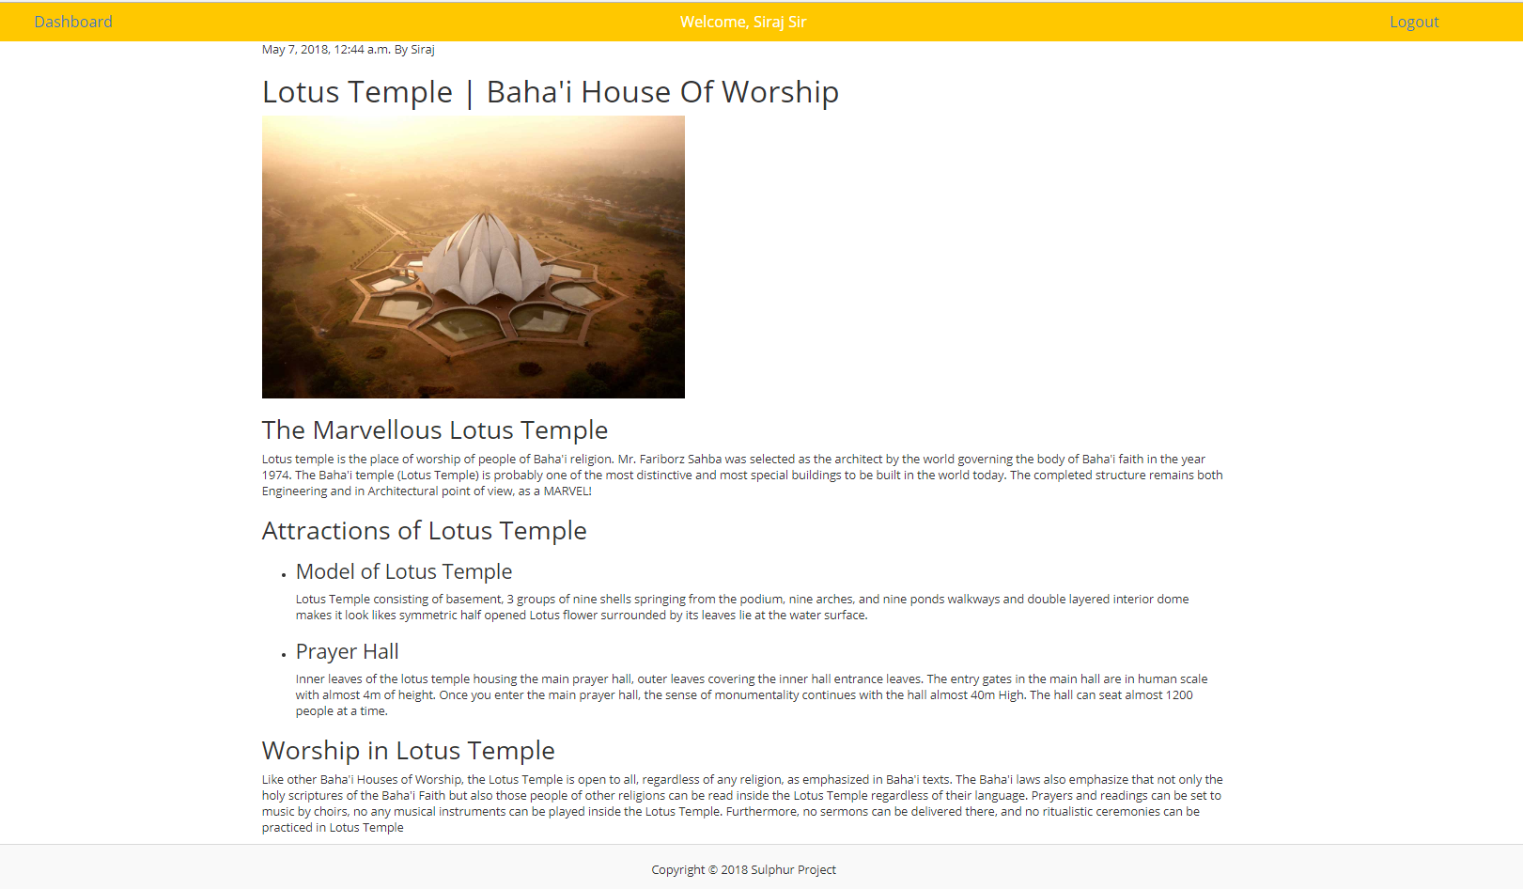
Sulphur interface

Slide 17
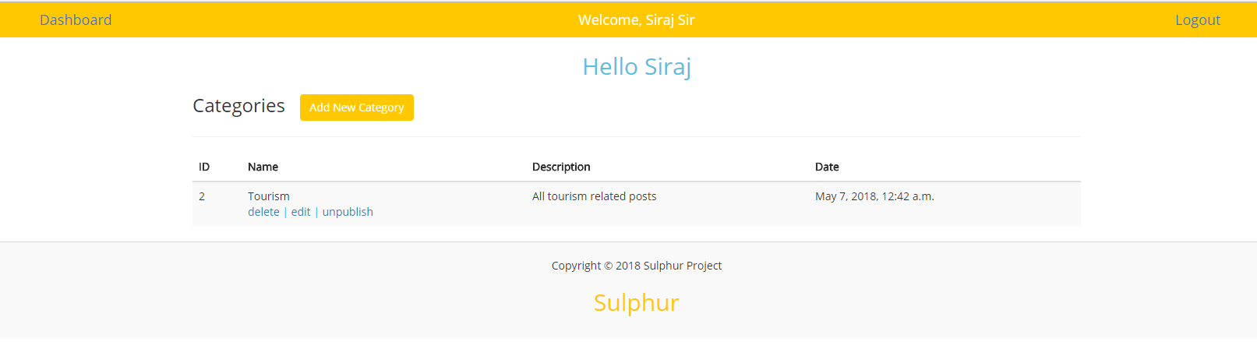
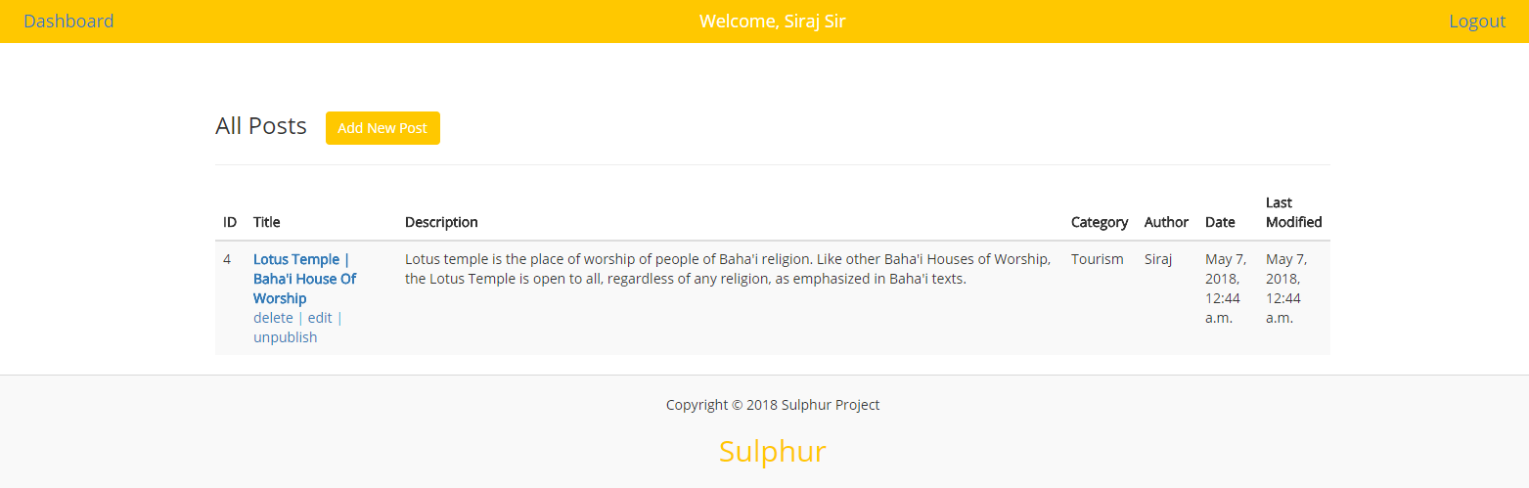
Sulphur interface

Slide 18
Thank you
Sulphur
Sulphur Project 2018

